Slide 1
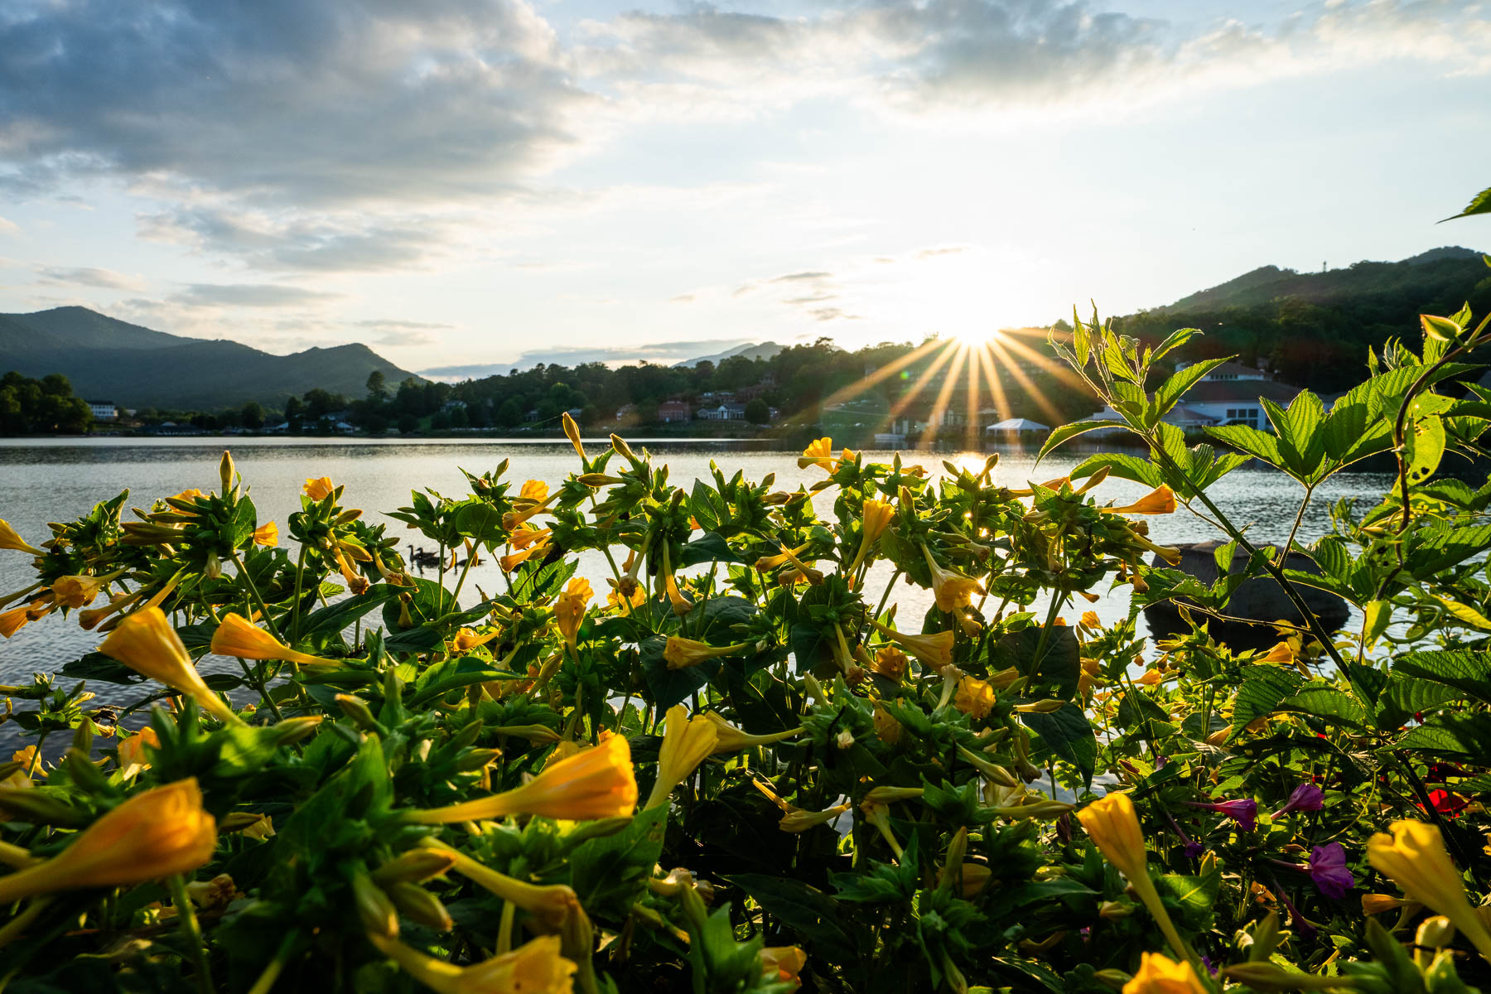


HAYWOOD COUNTY
TOURISM DEVELOPMENT AUTHORITY
March 27, 2024

Slide 2
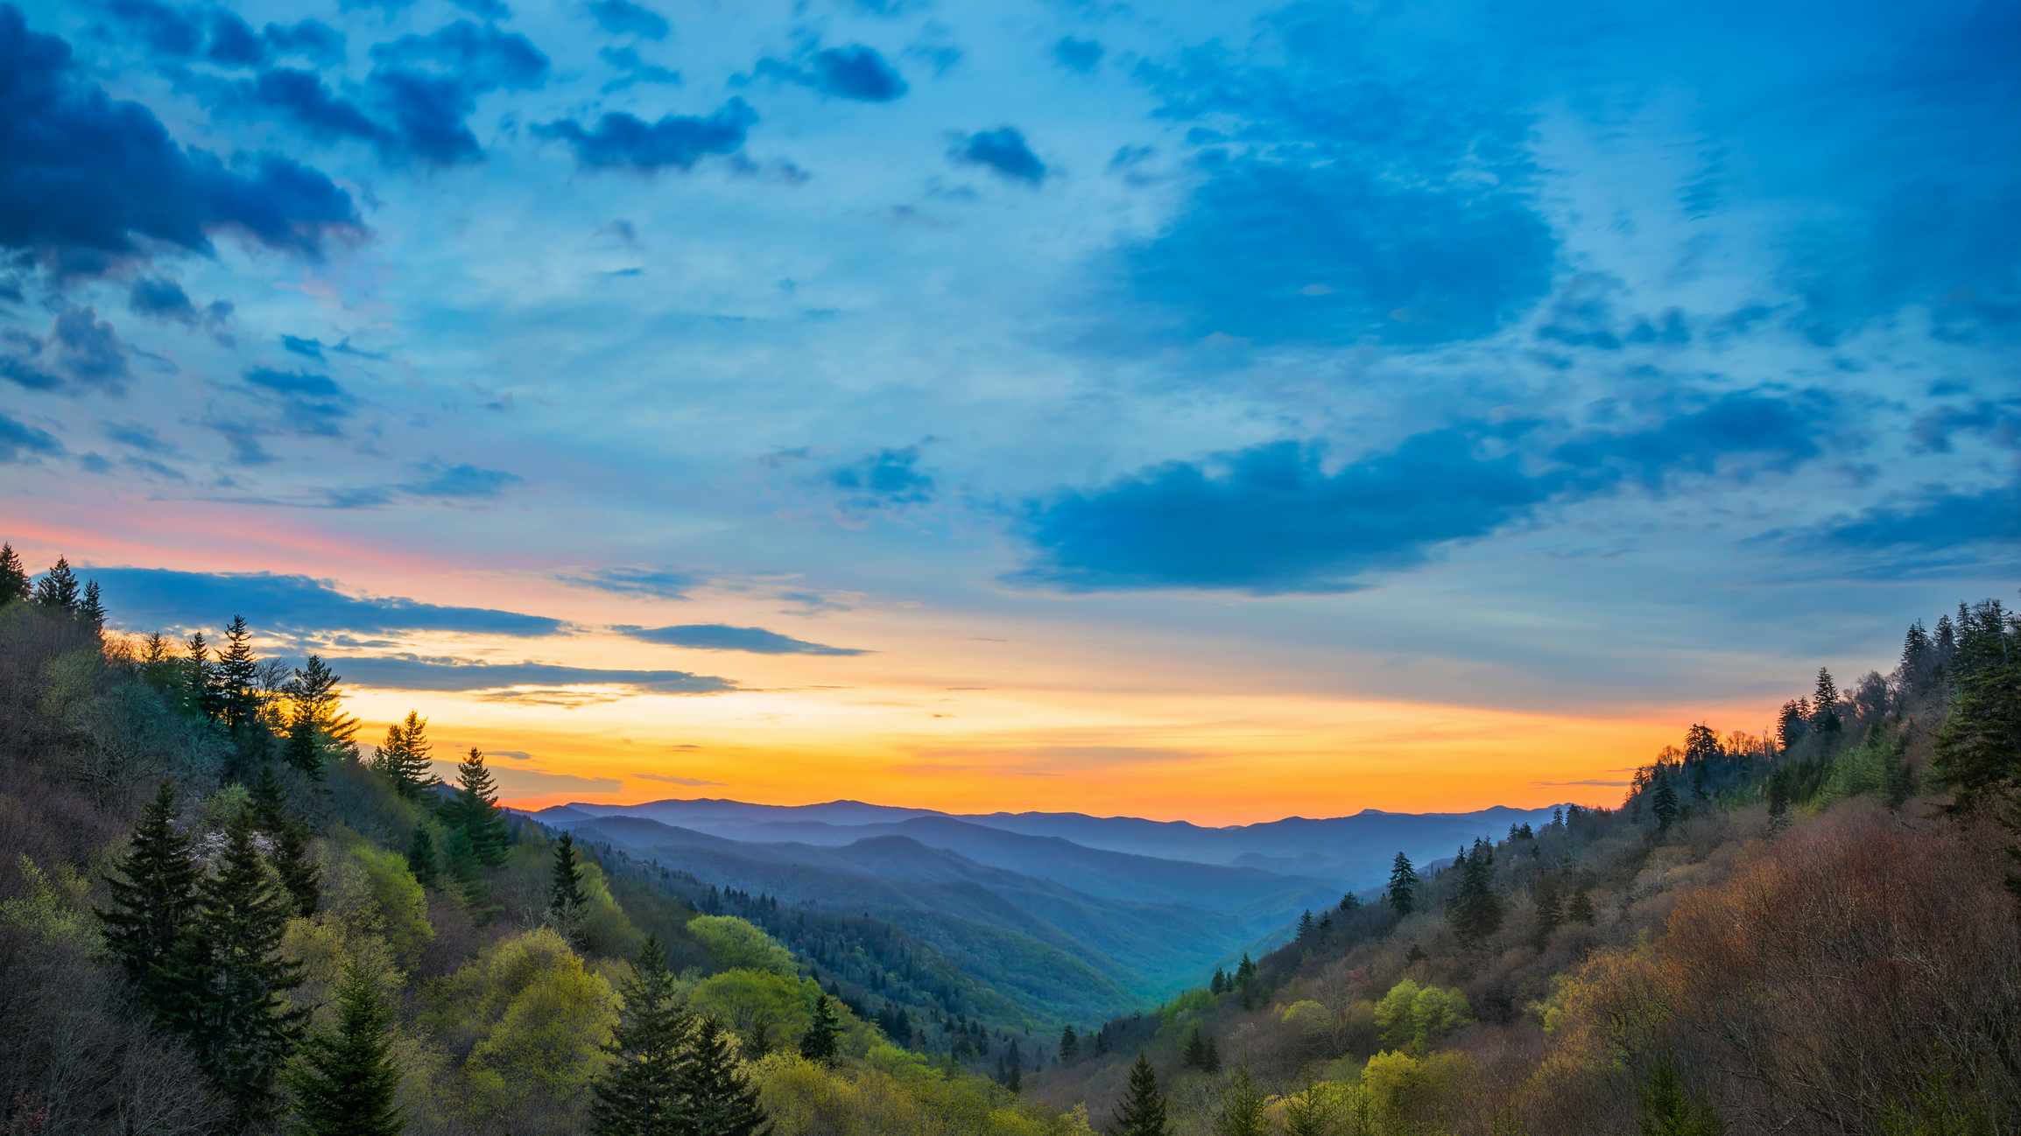

ELEVATING
NC SMOKIES
State of the Destination Analysis
Steering Committee March 26, 2024

Slide 3

The Purpose
TODAY - Testing Critical Issues
What Makes Sense?
Where Are We Off?
What Are We Missing?
NEXT - What Do We Do About It
Strategy Goals/Pillars
Objectives
Tactical Recommendations
Notes:
SR

Slide 4


Fully
Current Visitors
79%
There is a high level of repeat visitation and a strong overnight visitation of 3+ nights among current visitors.
are repeat visitors to Haywood County
Times visited Haywood County
in the past 3 years
Length of stay
during most recent visit
8+ nights
Daytrip
Only
20%
3-7 nights
1 night
come as day visitors
2 nights

Slide 5
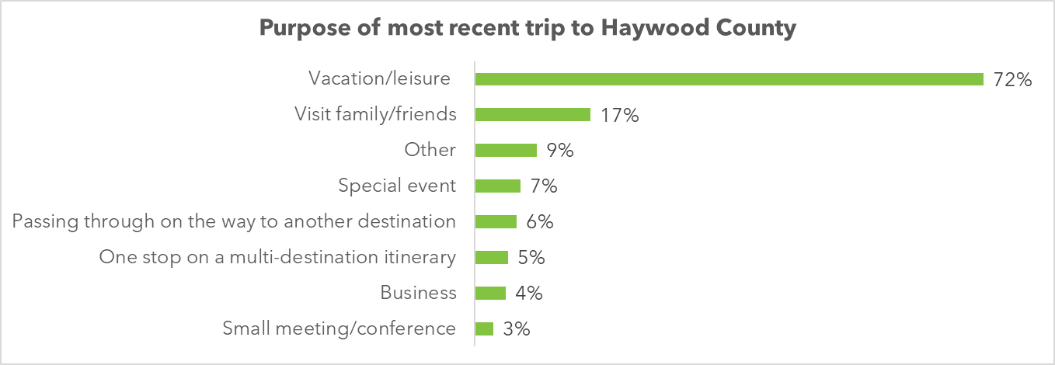
Purpose of Visit
Independent leisure drives Haywood County
Limited business and small meeting

Slide 6
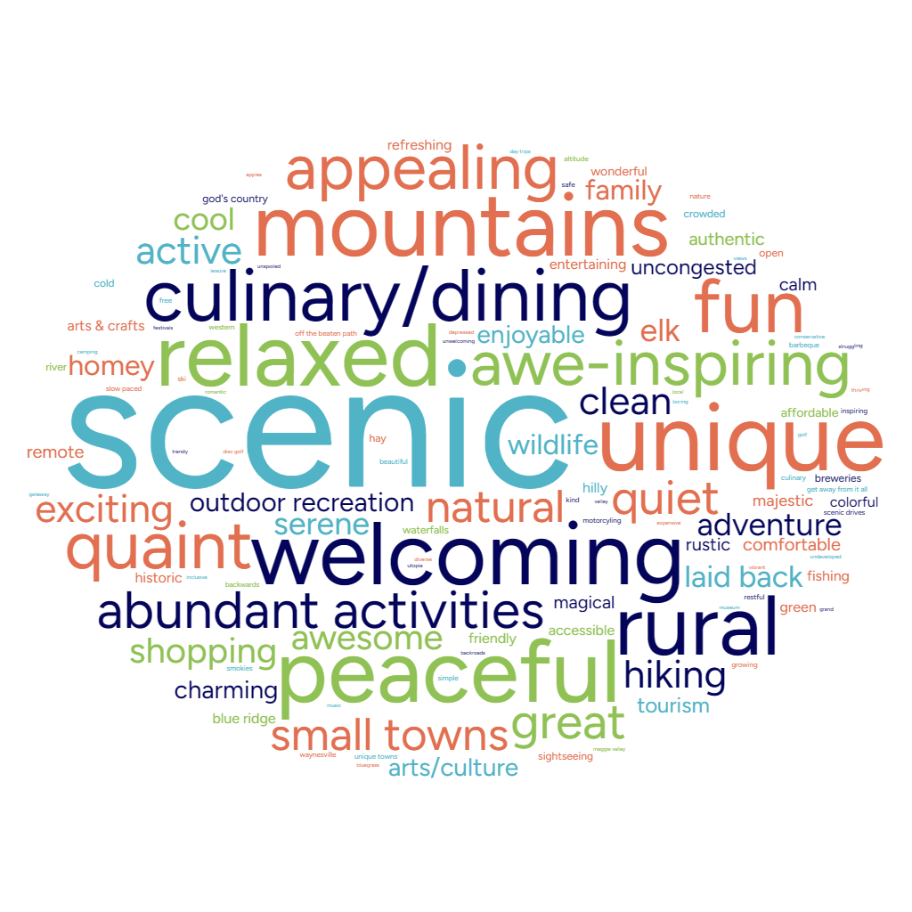
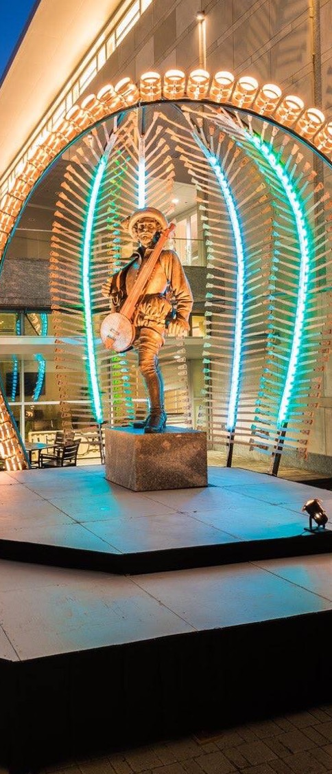
Current Visitors
What are
3 words to describe Haywood County?

Slide 7
CURRENT VISITORS
Passive outdoor recreation was the top driver of past visitation to Haywood County.
Q: What activities did you participate in during your most recent trip to Haywood County? (choose all that apply)

Slide 8
Current visitors have very positive perceptions of Haywood County as a leisure destination.
79%
of visitors rate Haywood County’s appeal as a destination as a “4” or “5”.

Slide 9









POTENTIAL VISITORS
Potential visitors are interested in passive outdoor activities along with festivals, culinary, breweries, and shopping on future visits.
42%
Breweries, Distilleries & Wineries
Potential visitors under 55 rank water activities including kayaking/ canoeing and river tubing 7 to 9 points higher than our current over 55 visitors.
56%
Scenic Drives
52%
Sight Seeing
42%
Shopping
52%
Festivals
38%
Wildlife Watching
50%
Dining/Culinary
37%
Arts & Crafts
Q: What type of attractions, events or amenities would entice you to visit Haywood County, NC?

Slide 10
Key Findings
Land Use
  Outdoor recreation infrastructure and improvement of connectivity of towns and trails benefits residents and visitors
  Monitoring the progress of urban sprawl development.
  Aging infrastructure and other placemaking enhancements will require future investments.
Environmental Resources
  Flooding poses one of the greatest risks to the entire destination.
  Water quality downstream of the mill remains a concern.
  Managing wildlife interactions at STRs (e.g. waste management) to avoid risks to human and wildlife safety.
  Public lands in Haywood County are popular but don't seem to be exceeding capacity so it is important to keep it that way. Working with outdoor recreation and land manager partners is a must.
Sustainable destination management priorities
    The TDA's is conducting a priority assessment using the Mountain IDEAL international standard for sustainable destination management.

Slide 11
Next Steps

Slide 12
Next Steps
Take feedback from Steering Committee and Community Input Session &
refine critical issue thinking
Move into the Destination Master Planning stage
Develop a mix of plan Goals/Pillars, Objectives, Strategies and Tactics
Return in May to review draft recommendations
Deliver Destination Master Plan in August

Slide 13
ELEVATING
NC SMOKIES
State of the Destination Analysis
Steering Committee March 26, 2024

Slide 14
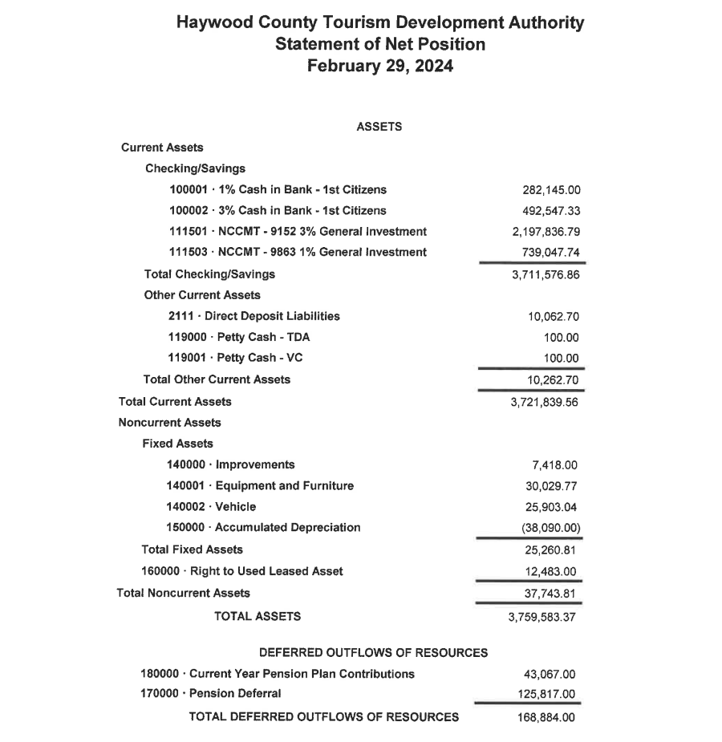
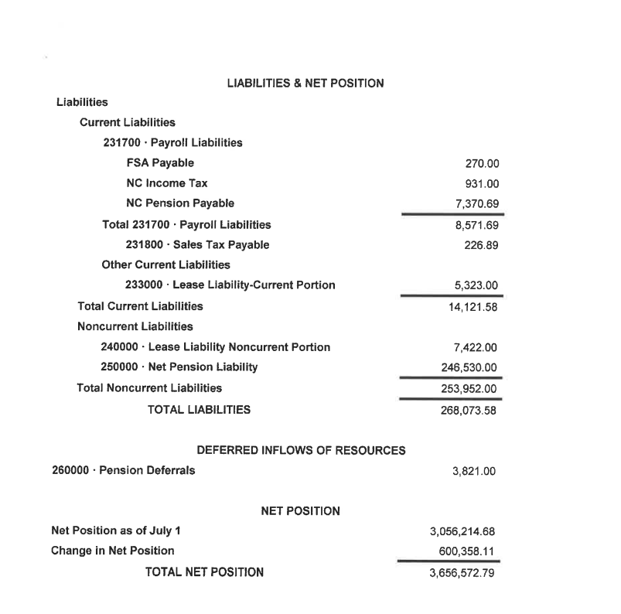
https://haywoodcountytourismdevelopment.files.wordpress.com/2024/03/february-financials-1.pdf

Slide 15
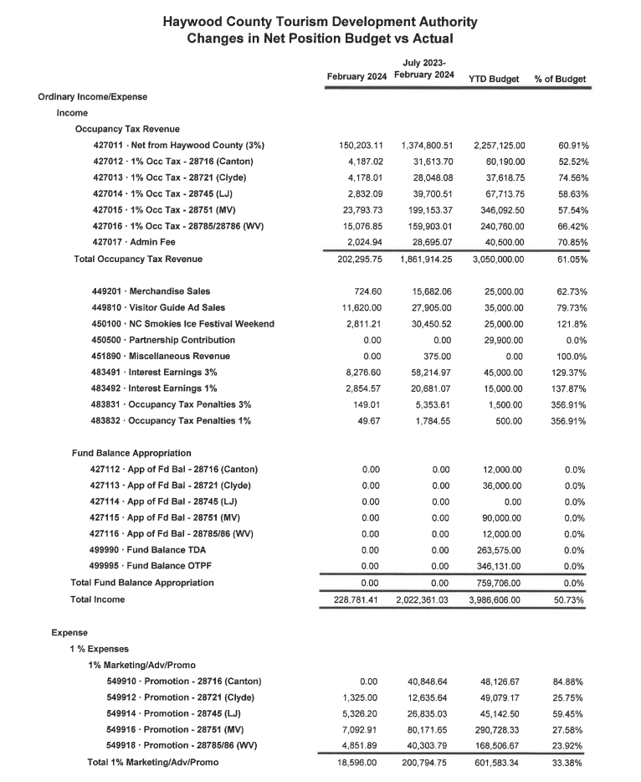
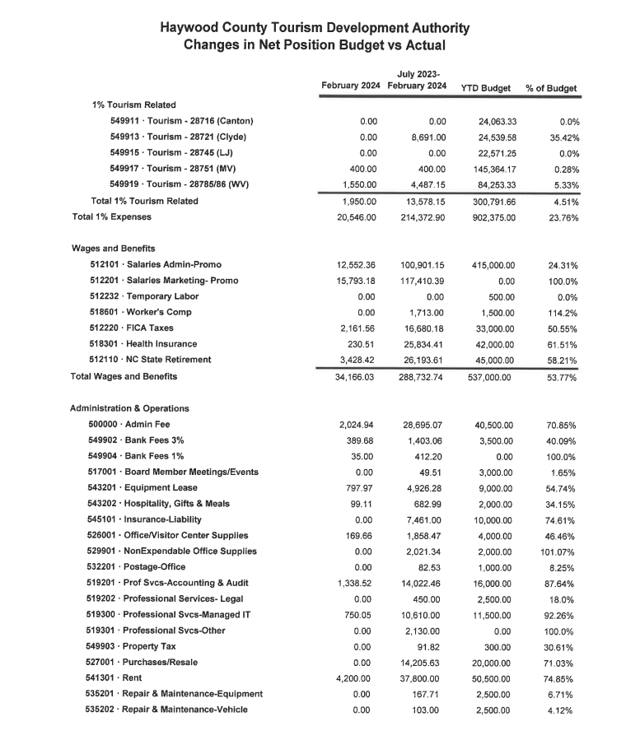

Slide 16
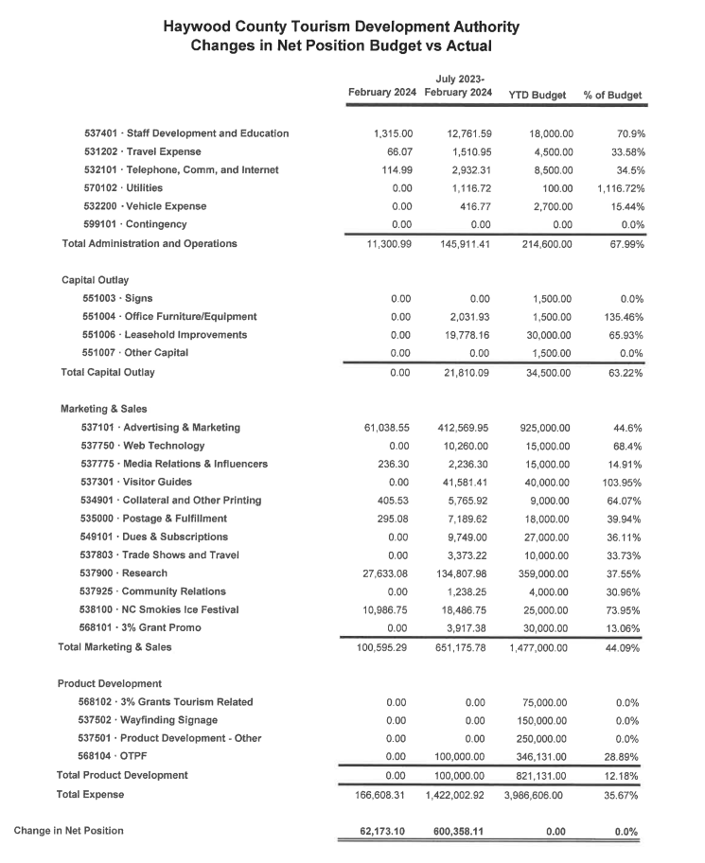

Slide 17
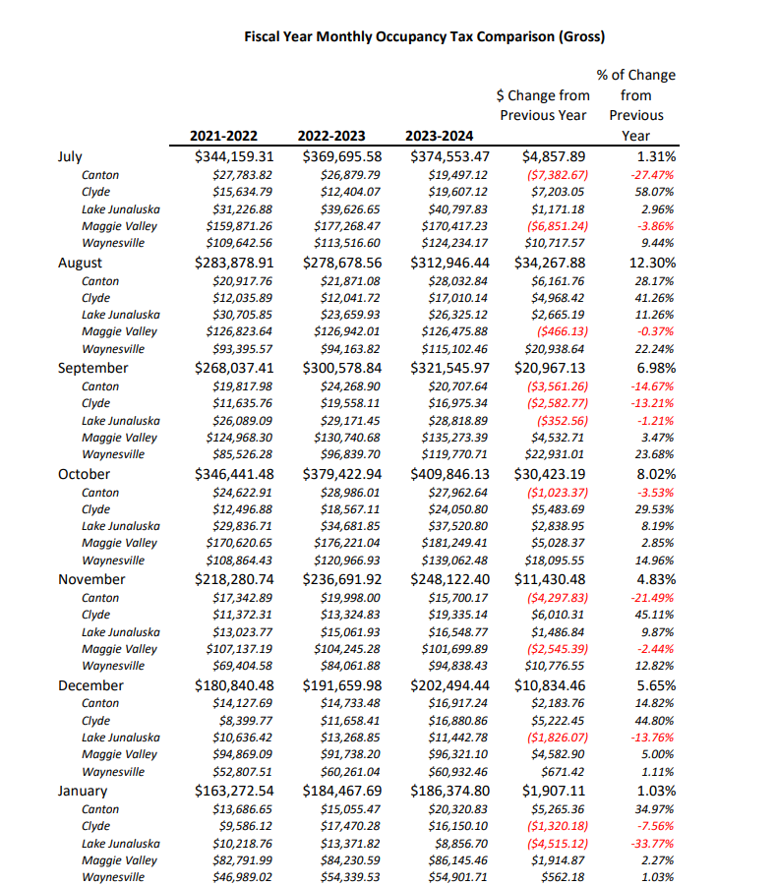
https://haywoodcountytourismdevelopment.files.wordpress.com/2024/03/hctda-occtaxcomparison_01.2024_numbers.pdf

Slide 18
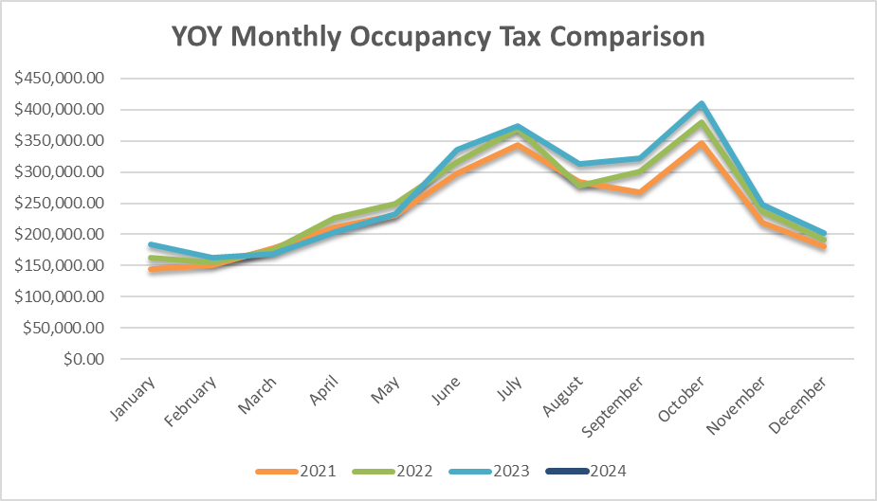

Slide 19
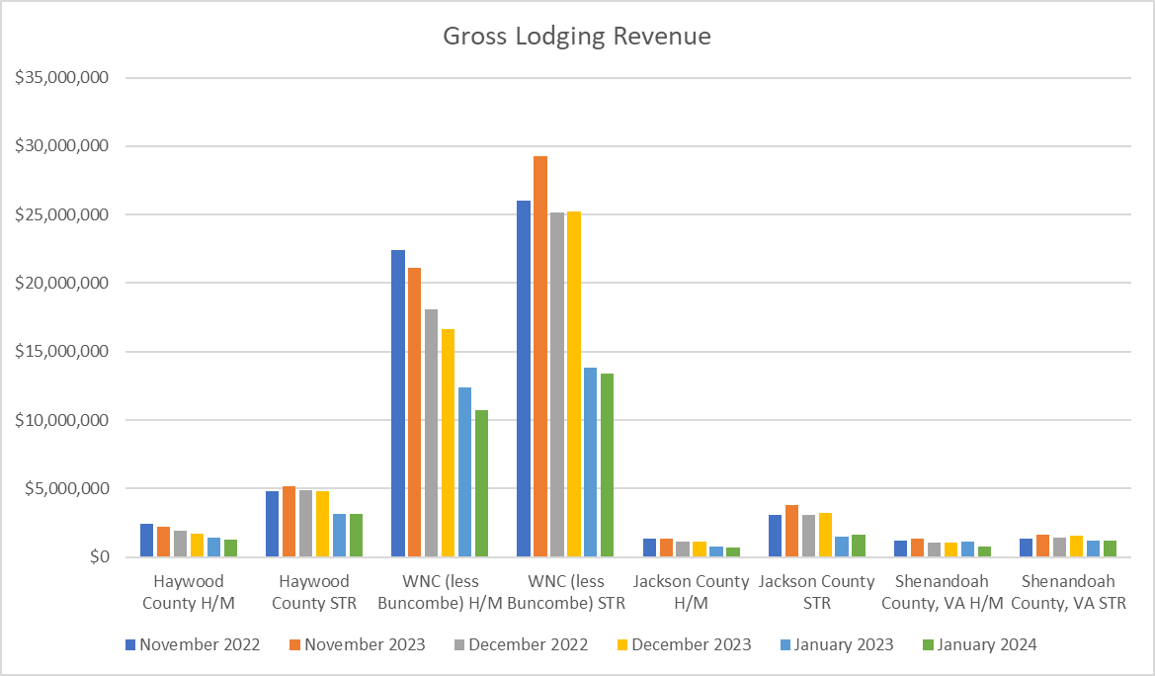



Slide 20
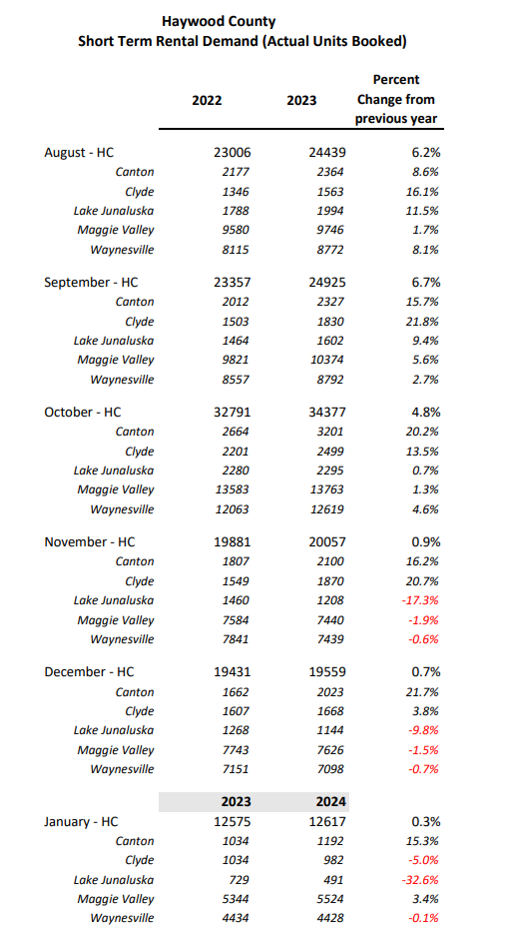
https://haywoodcountytourismdevelopment.files.wordpress.com/2024/03/hctda_shorttermrentaldemand_01.2024.pdf

Slide 21
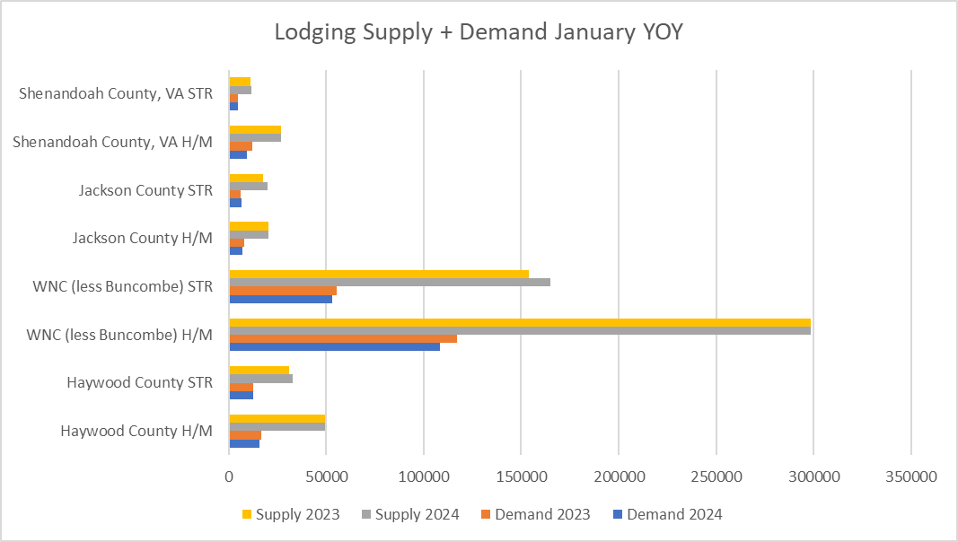

Slide 22
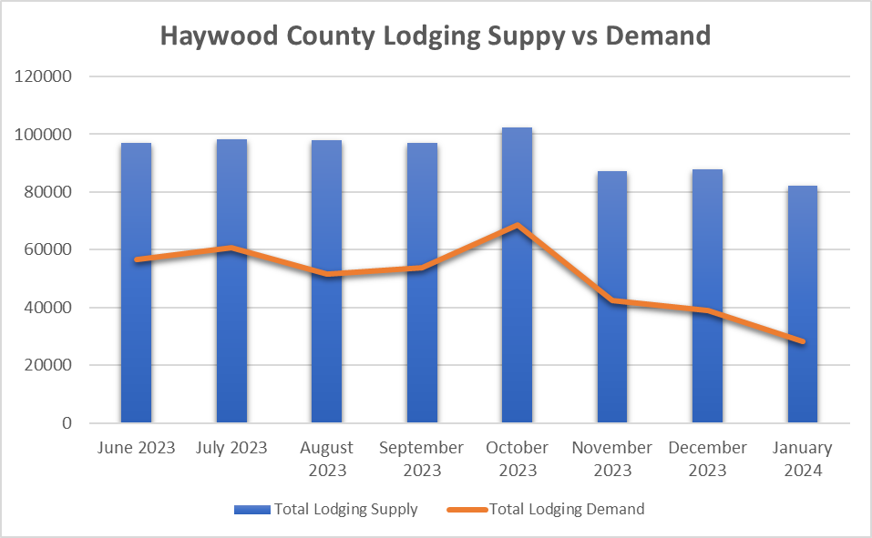

Slide 23
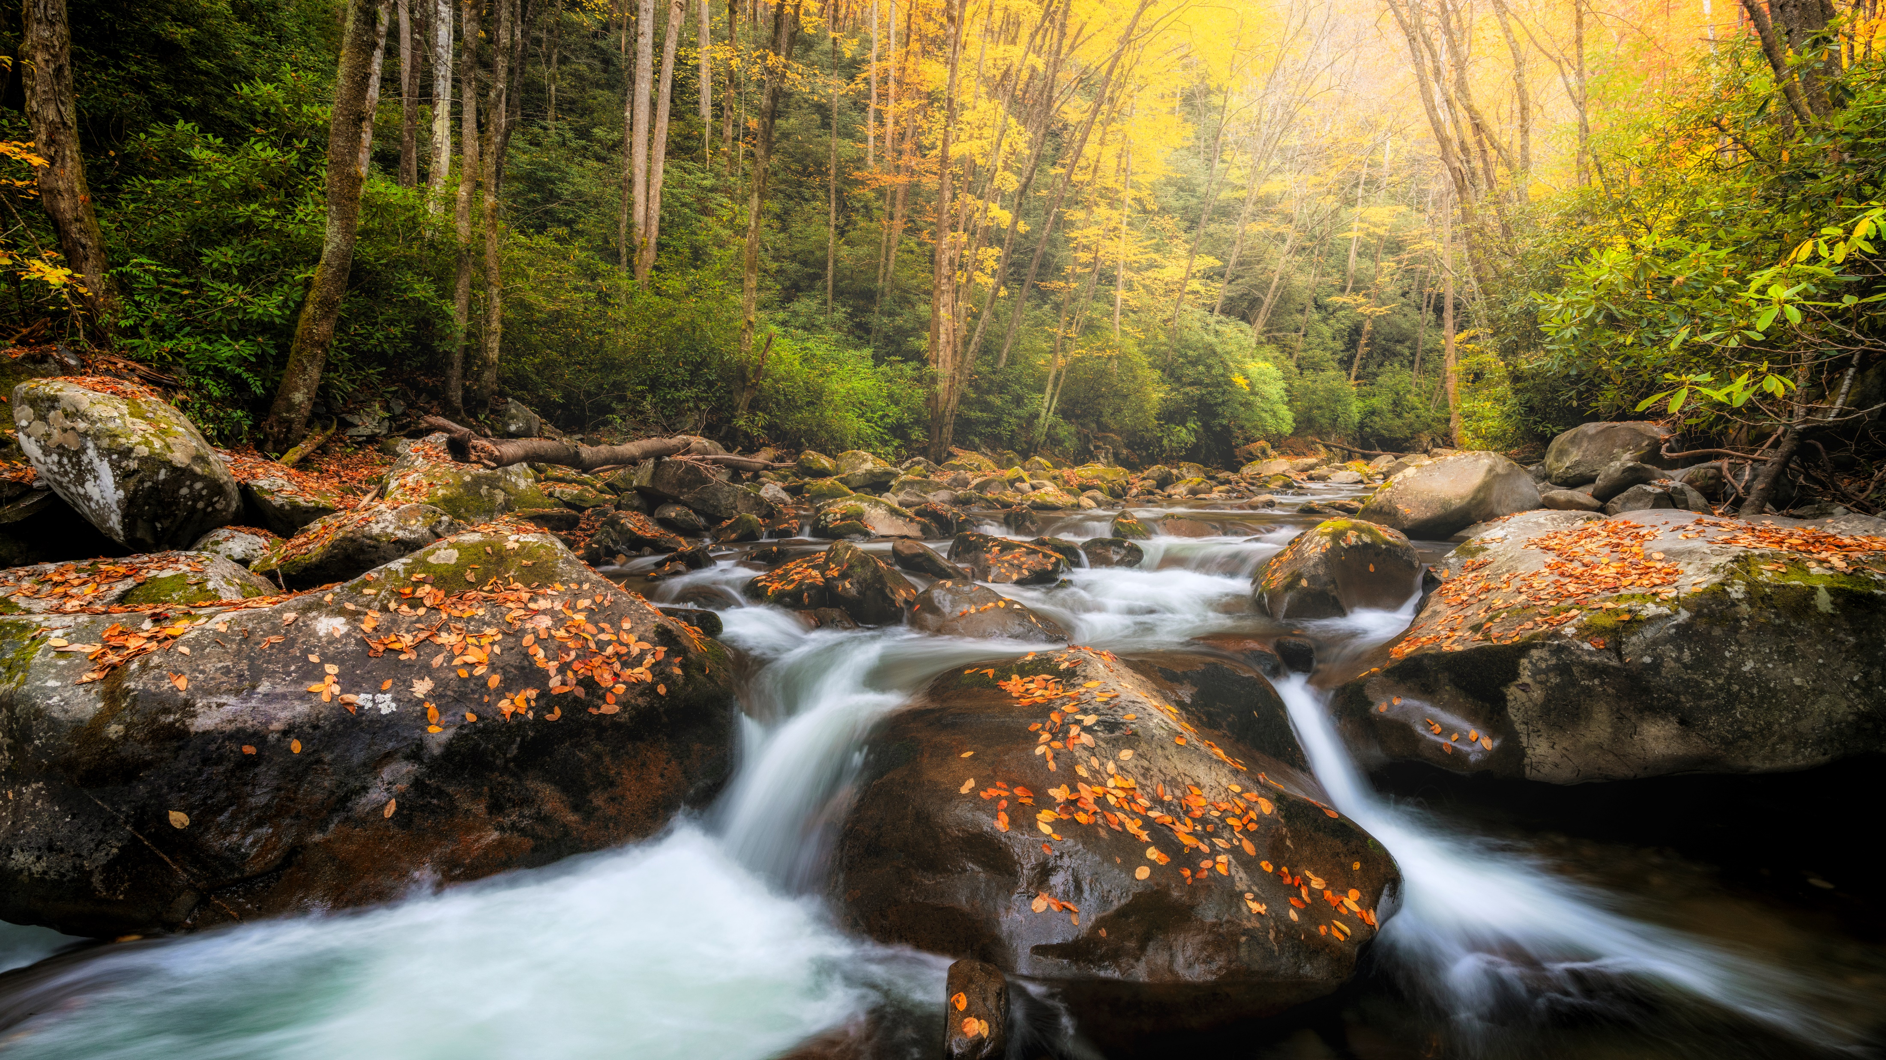
Old Business

Slide 24
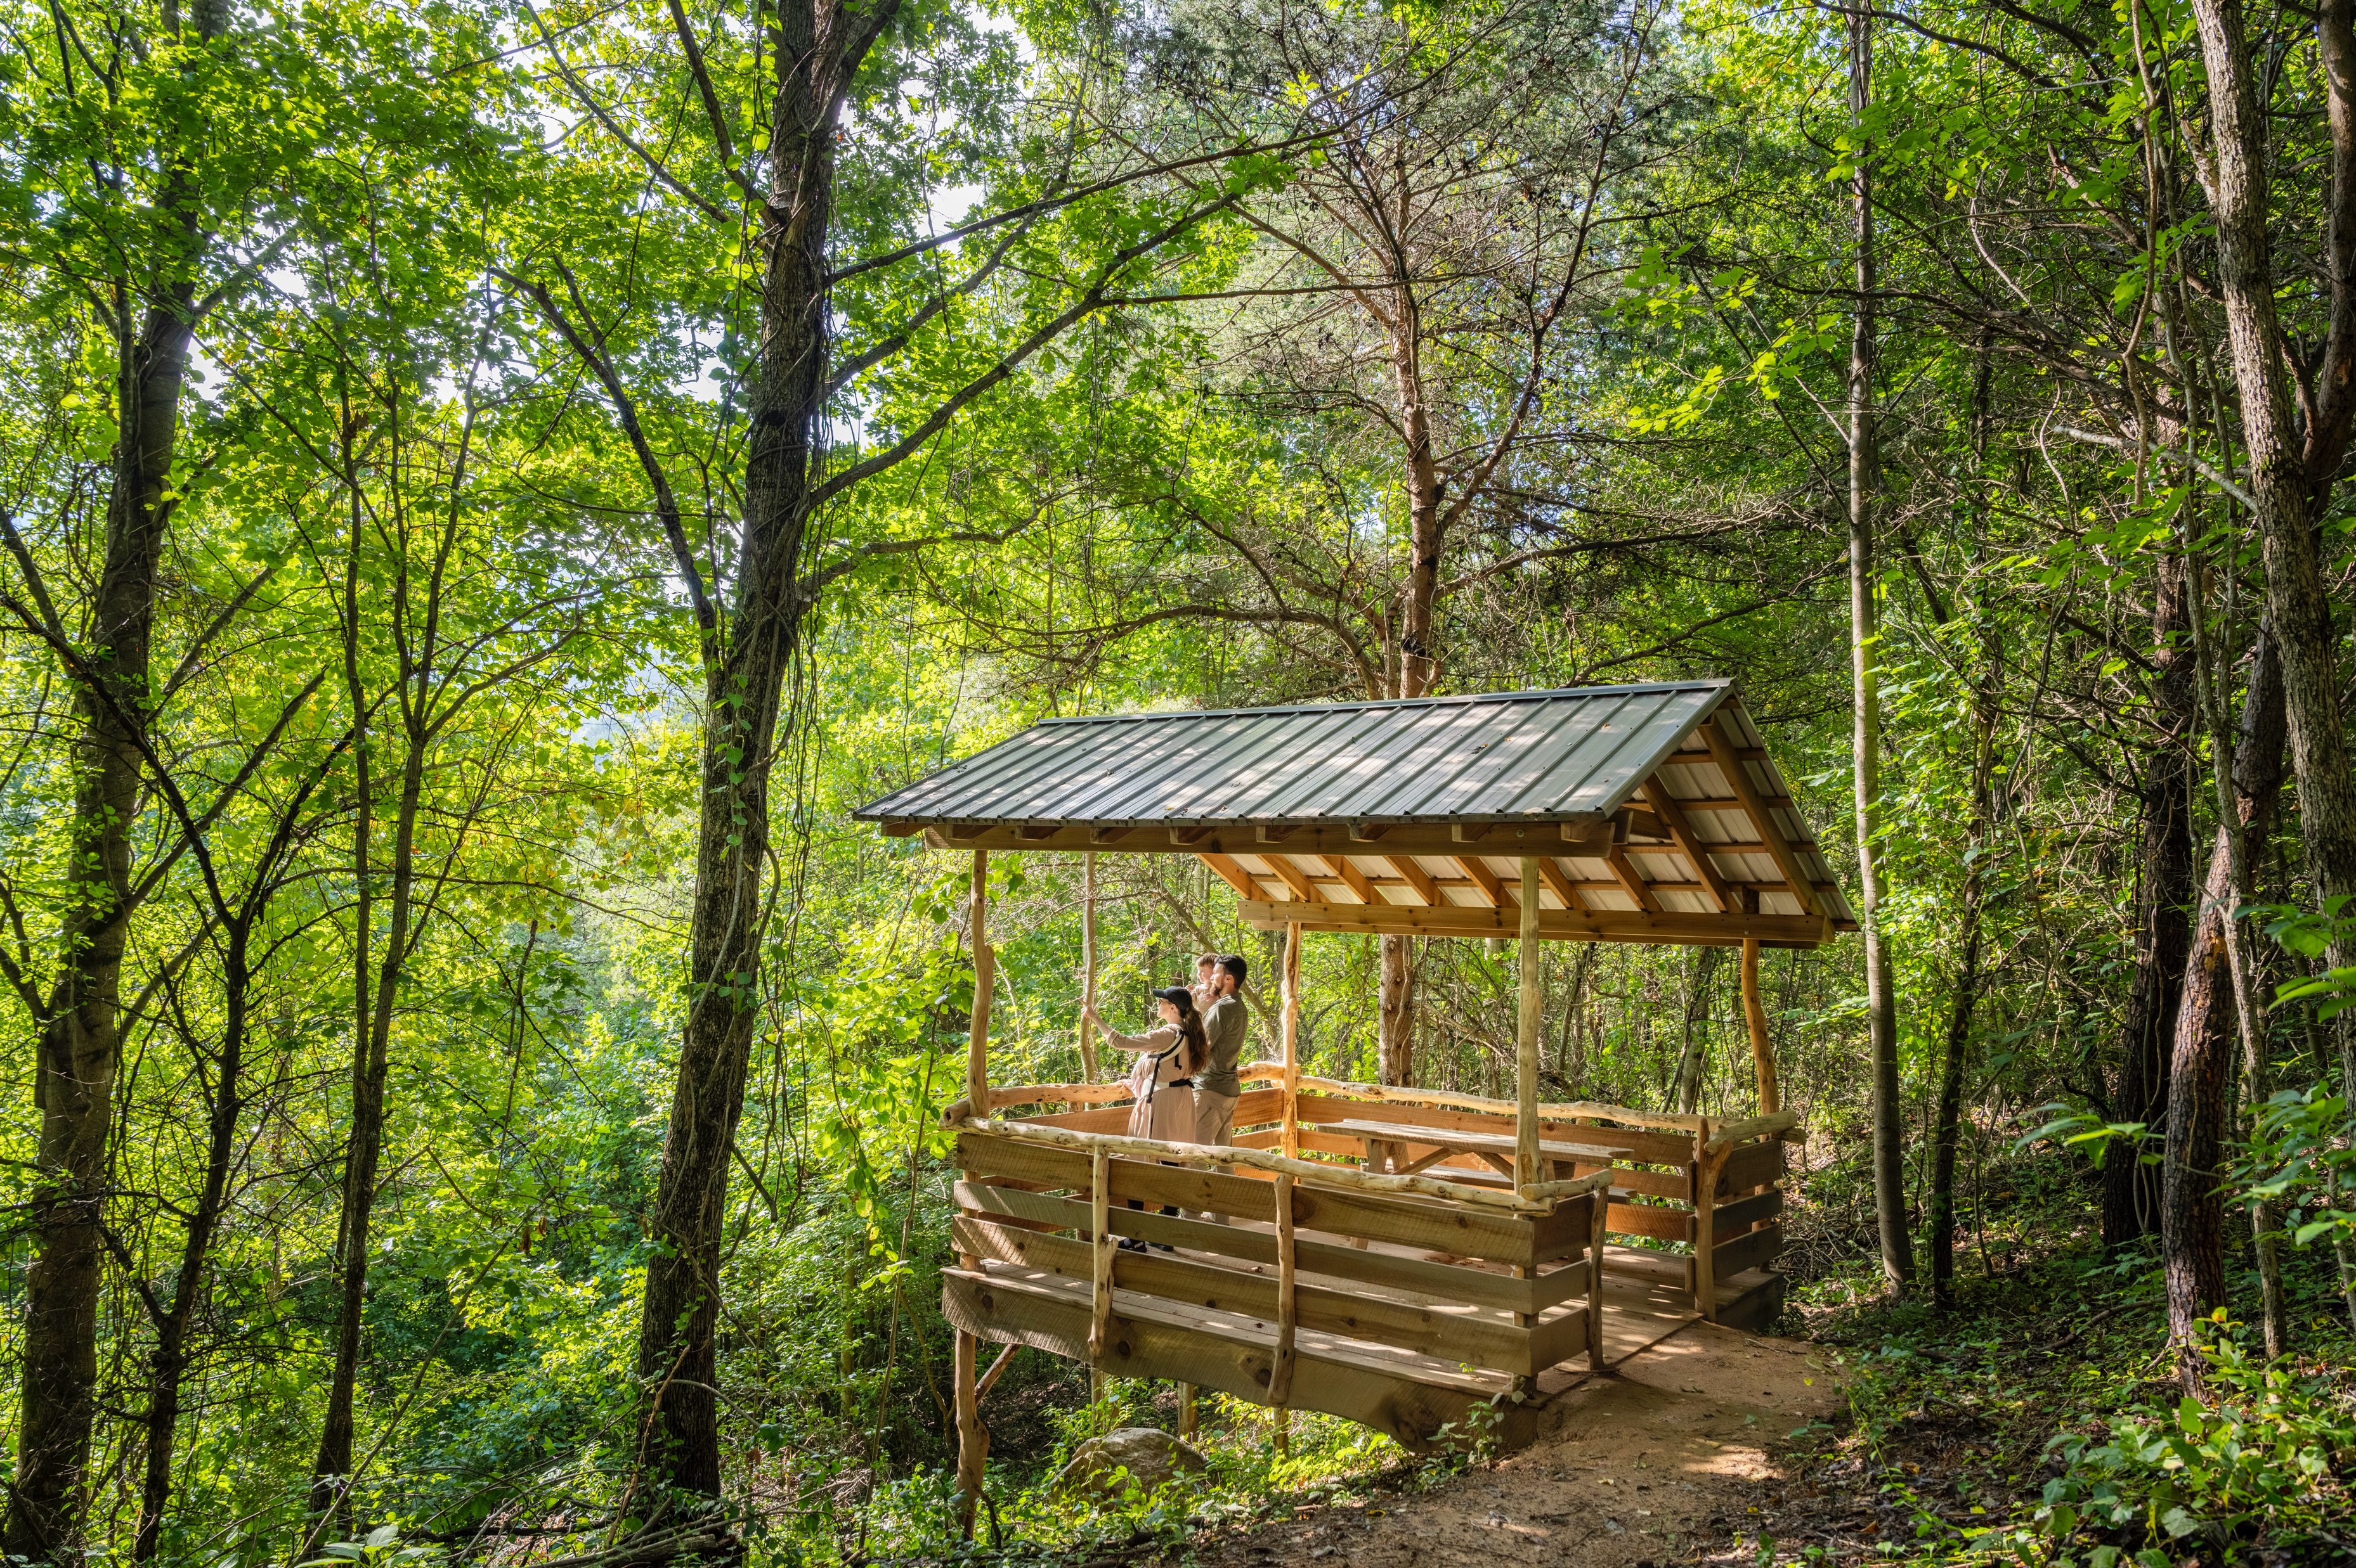
Grant Extensions from FY 23-24 to FY 24-25
Downtown Waynesville Commission
Alleyway Mural
$5,000
Zip Code Tourism Expenditure Fund
Town of Canton
Chestnut Mountain Kids Bicycle Playground
$2,400
Zip Code Tourism Expenditure Fund
Haywood County Recreation & Parks
Francis Farm Bike Park
$150,000
One Time Project Fund

Slide 25
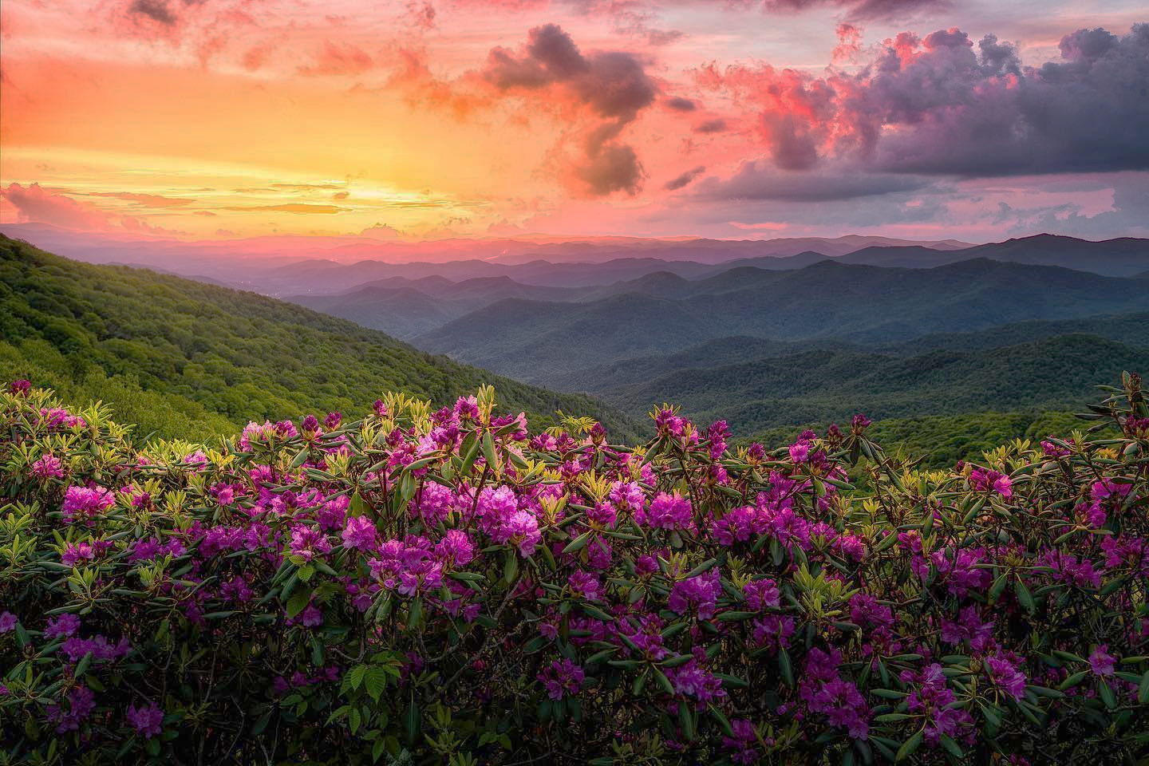
New Business

Slide 26
Grant Improvements
Per Session Law 2007-337, House Bill 1013:
The Haywood County Tourism Development Authority shall use at least two-thirds of the funds to promote travel and tourism in the county and shall use the remainder for tourism-related expenditures.
Promote Travel & Tourism:
To advertise or market an area or activity, publish and distribute pamphlets and other materials, conduct market research, or engage
in similar promotional activities that attract tourists or business travelers to the area.
Tourism-Related Expenditures:
Expenditures that, in the judgement of the HCTDA, are designed to increase the use of lodging facilities, meeting facilities, and convention in the county by attracting tourists or business travelers to the county. The term includes tourism-related capital expenditures.
Temporarily on hold

Slide 27
NEW
Legacy Event Sponsorship
Haywood County is home to a rich collection of long-standing events that have become an important part of our community's character. These events draw in visitors, showcase our unique appeal, and contribute significantly to our local economy. We're looking for innovative approaches, impactful enhancements, and exciting new features that will propel these events to even greater heights. The Legacy Event Sponsorship program aims to ensure that Haywood County's valued events continue to thrive, captivate audiences, and generate lasting economic and cultural impact.
Legacy Events must meet the following criteria:
The event must have been held in Haywood County for at least 10 consecutive years
The event must have a proven track record of attracting both local and broader audiences. This includes:
  Minimum attendance of at least 1,000 attendees per event
  At least 25% of attendees coming from outside Haywood County based on historical data or verifiable estimates.
The event must demonstrate a positive contribution to Haywood County's tourism economy and reputation as a destination. This could include:
  Increased lodging occupancy
  Increased spending in local businesses
  Positive media coverage and promotion of Haywood County
The requested sponsorship amount must be no more than 25% of the total event budget.
These are the key areas we'll consider when awarding sponsorships:
Impact on Tourism: How the event promotes Haywood County as a visitor destination to a wider audience than our local market.
Economic Impact: The potential impact on lodging occupancy, tax generation, and direct spending through increased travel and tourism activity within Haywood County.
Innovation: Whether the event showcases innovation, enhancements, or new features.
Community Benefit: The overall benefit the event provides to the Haywood County community including demonstrated strong partnerships with local businesses or organizations.

Slide 28
IMPROVED
Tourism Promotion Grants
The Haywood County Tourism Development Authority's Grant Program is designed to enhance tourism through innovative promotion and development of tourism-related events, activities, and experiences. There are three categories of types of funding:
1. Advertising
2. Market Research
3. Other Promotional Activities that attract visitors to Haywood County
Who Can Apply:
Not-for-profit organizations, museums, attractions, governmental agencies, or other non-profit tourism entities. Not-for-profit organizations must have a minimum grant match of 50%.
For-profit, tourism-based organizations may apply with a minimum grant match of 100%.
These are the key areas we'll consider when awarding grant funding:
Visitor Attraction and Economic Impact: Ability to attract new and increased overnight visitation and potential for economic impact, including its ability to generate revenue, create jobs, and boost local businesses.
Innovation and Uniqueness: Creativity, uniqueness, and its contribution to diversifying Haywood County's tourism offerings. Projects that offer new, novel experiences or fill a gap in the current tourism landscape score higher.
Collaboration and Community Support: Demonstrating strong collaboration between multiple entities (e.g., local businesses, non-profits, government agencies) and having significant community support or involvement are awarded higher points.
Seasonal and Off-Peak Promotion: The project/event aims to extend the tourism season by attracting visitors during off-peak times, contributing to a more even distribution of tourism throughout the year.

Slide 29
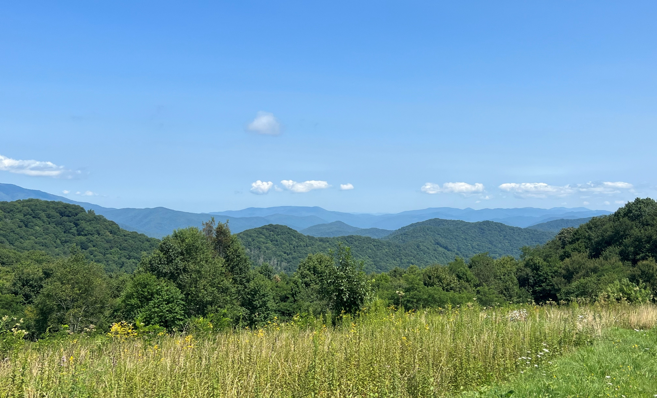
Staff Reports

Slide 30
Grant Timeline & Workshops
March 28
9AM Workshop
April 10
2PM Workshop
May 15
Mandatory preliminary application deadline - 5PM
May 16-24
HCTDA internal review, feedback and outreach to applicants
May 22
TDA Board vote on early FY 24-25 Legacy Event(s) applications if necessary
June 3
Final deadline to submit revisions to application
June 18
PDC meets to determine recommendations on applications received
June 26
TDA Board votes on grants
https://haywoodtda.com/grants/

Slide 31
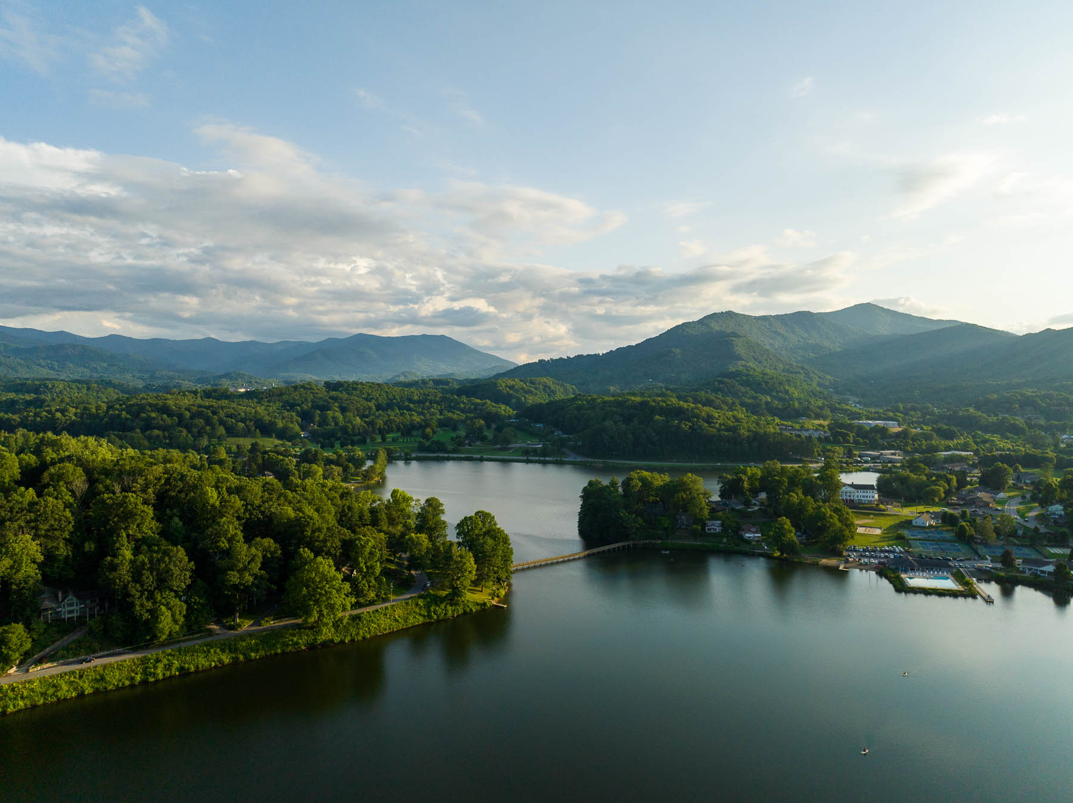
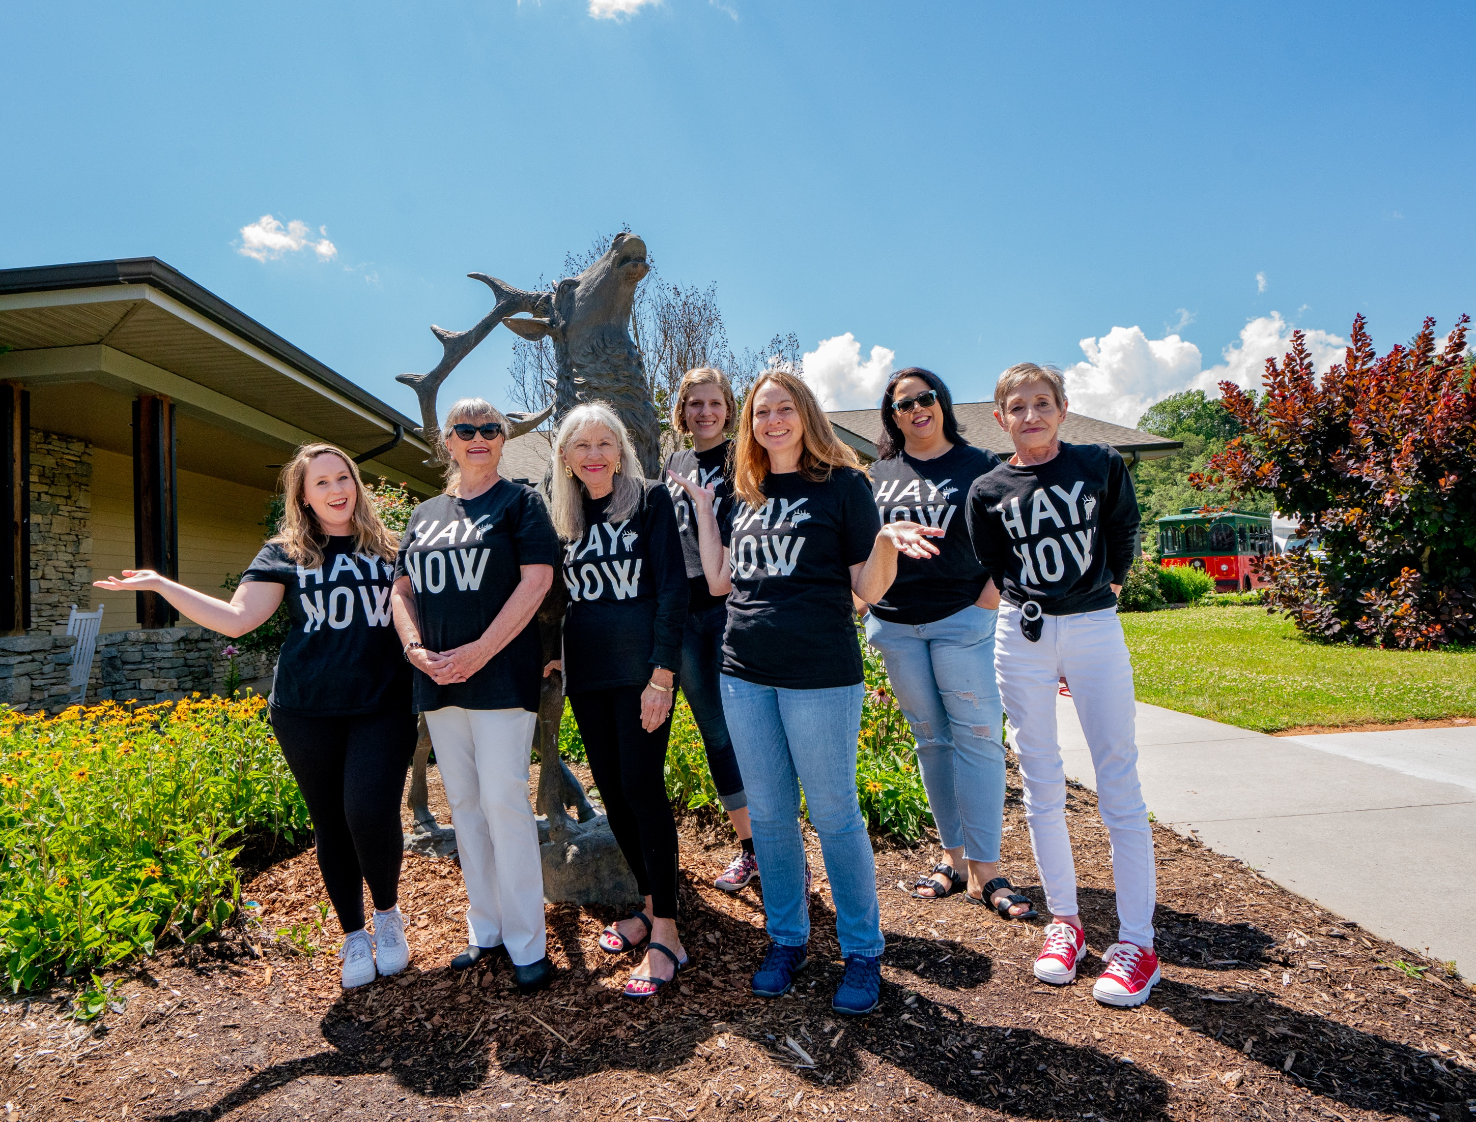
Lease Extension
Per the approved lease, we can renew for up to four, one-year terms. This extension is 1 of 4.
On Feb. 28, 2024, we submitted written intent to extend the lease through June 30, 2025
Per the lease, the monthly rent increases 5% so the new monthly rent will be $4,410

Slide 32


Jan 31, Feb 1 & 2 2025
NCSmokiesIceFest.com
2025 NC Smokies
Ice Festival Weekend
@NCSmokiesIceFest

Slide 33
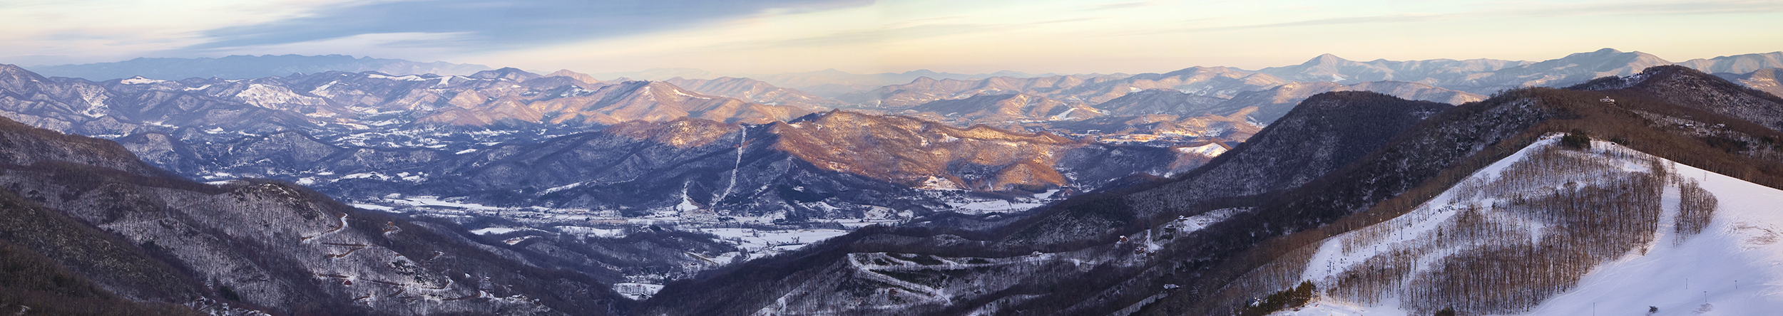
Ice Fest 2025 Seed Money
Type | Number | Amount
IFW Sponsorships (excluding in-kind) | 15 | $10,700
Downtown Waynesville Sculptures | 19 | $1,050
Canton Ice Rink Sculptures | 4 | $200
TOTAL: $11,950

Slide 34
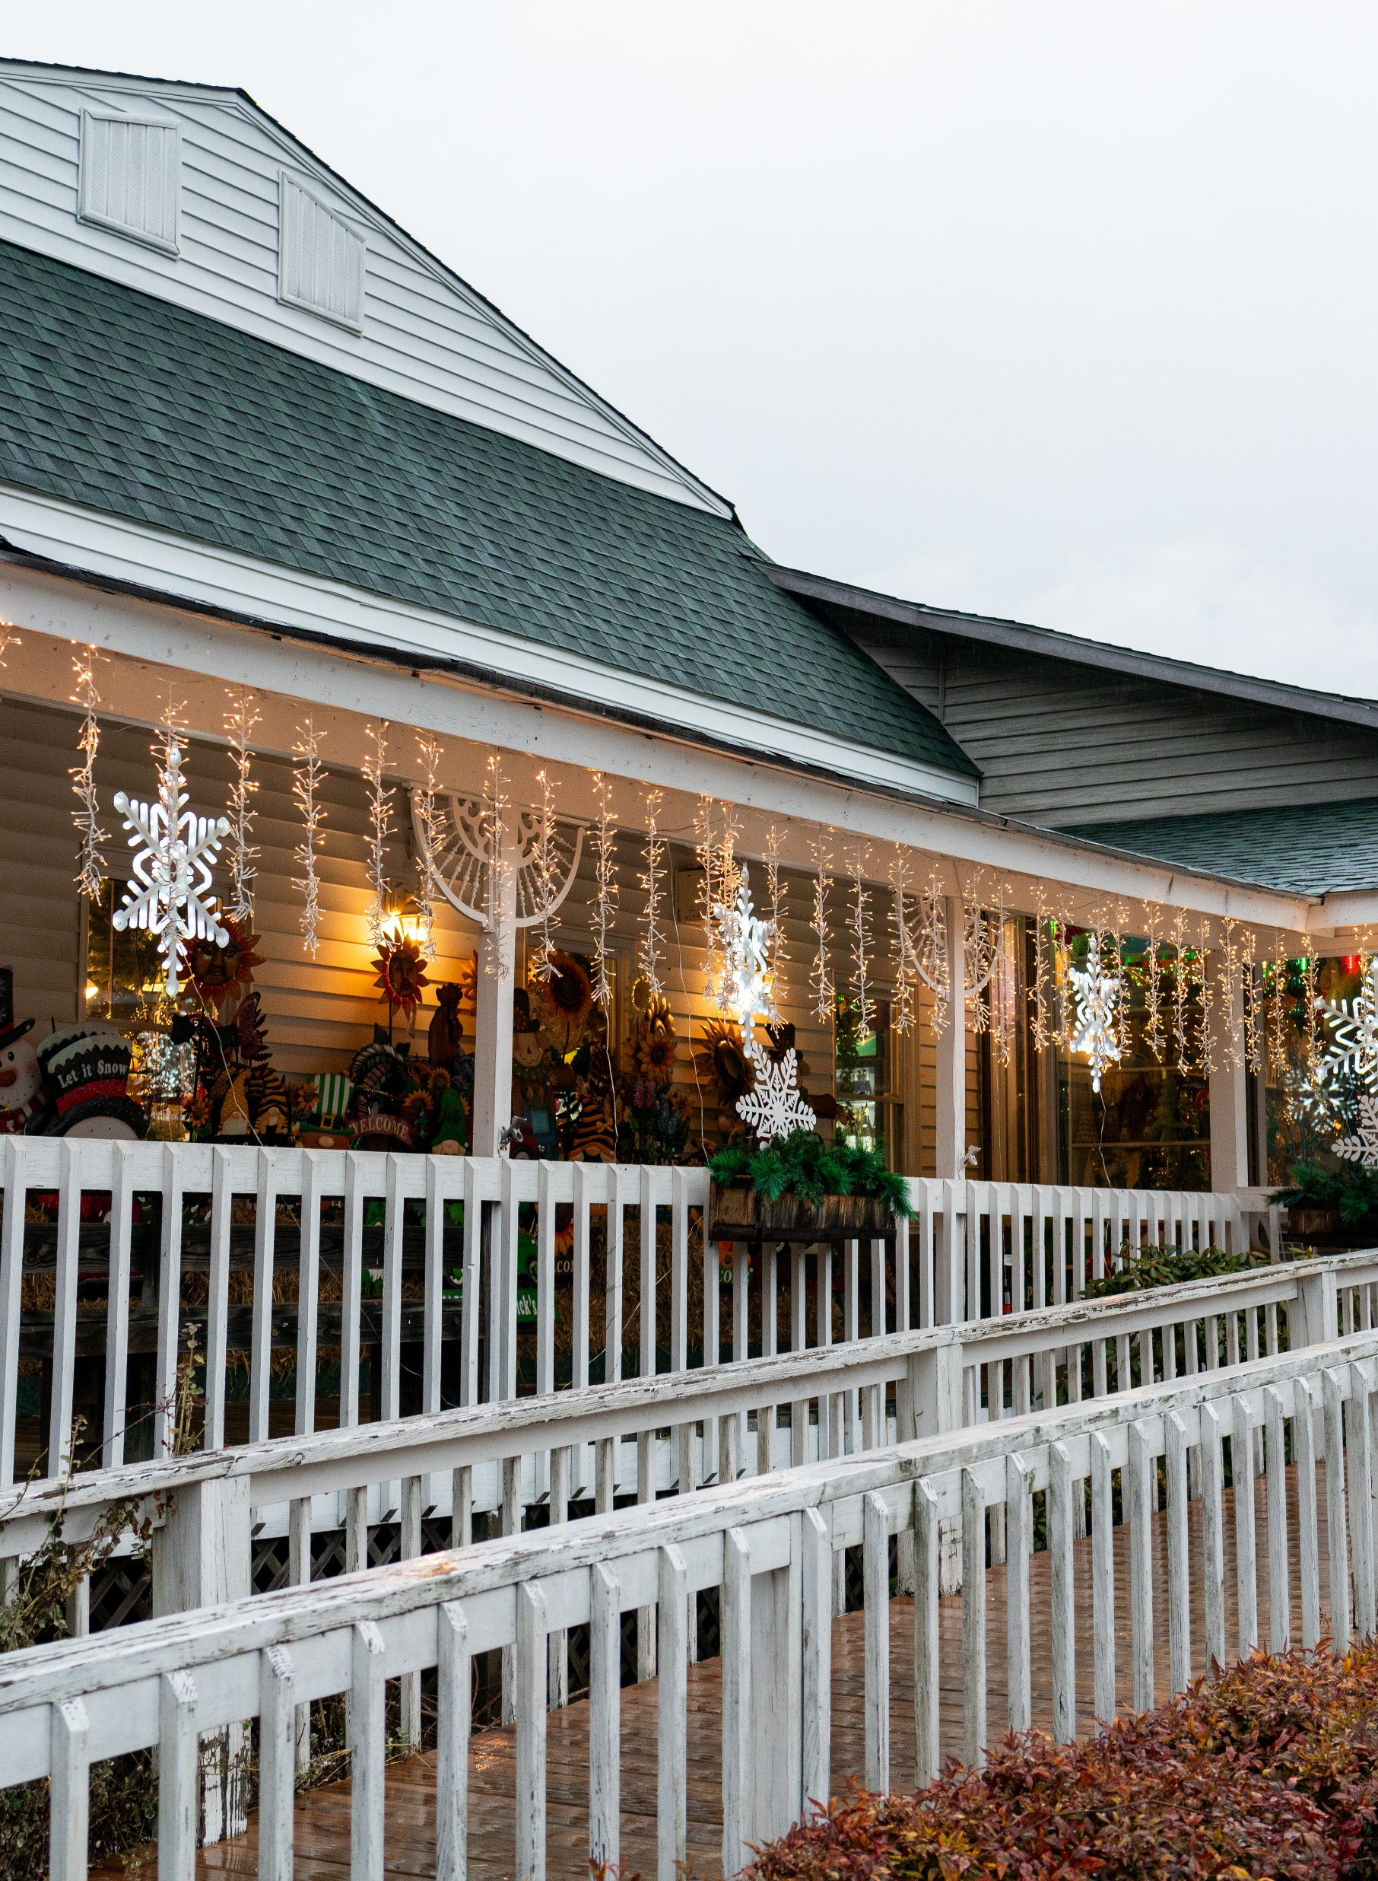
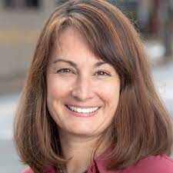

Media Coverage for 2025
We hosted 2 journalists during Ice Fest Weekend, guaranteeing us coverage for the 2025 event!
Vanessa Infanzon
Cardinal & Pine and
Charlotte Parent
Katie Kane
Our State

Slide 35
Committee Roundtable
What went well?
What can be improved upon?
Other suggestions or feedback?
Unanimous, enthusiastic support to continue to collaborate on a 2025 event

Slide 36
Next Steps?
Commit to the 2025 event and dates of January 31, February 1 & 2, 2025
Confirm TDA will continue to coordinate and manage IFW event; Maggie Valley will host and support at Festival Grounds
Start County-wide planning, coordination and securing sponsorships by May 9

Slide 37
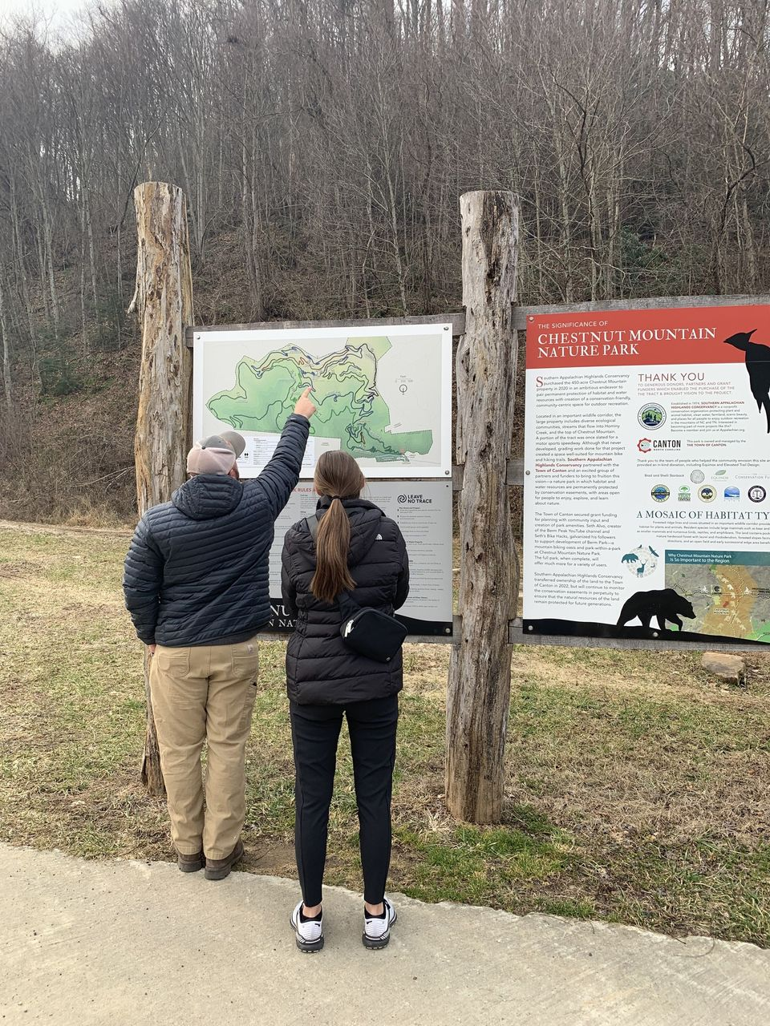
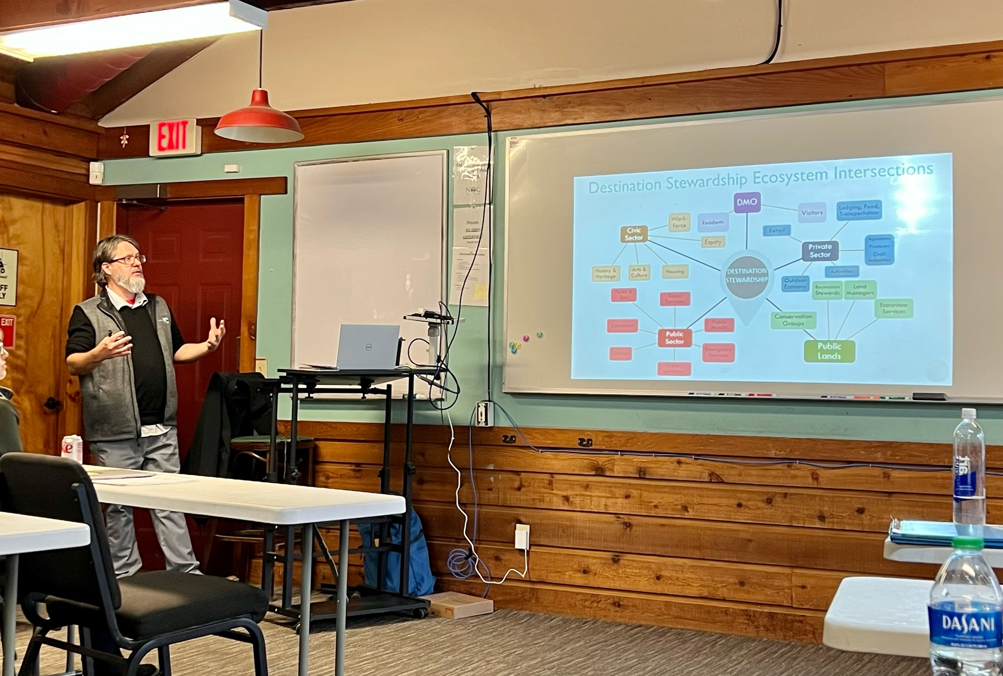

Outdoor NC Trail Town Program
What is the Trail Town program?
Designation that recognizes communities across NC for their diversity of trail experiences and celebrates stewardship efforts
We are 1 of 15 participating destinations
Outdoor NC Trail Town Visitor Guide
Accessible Trail Assessment

Slide 38
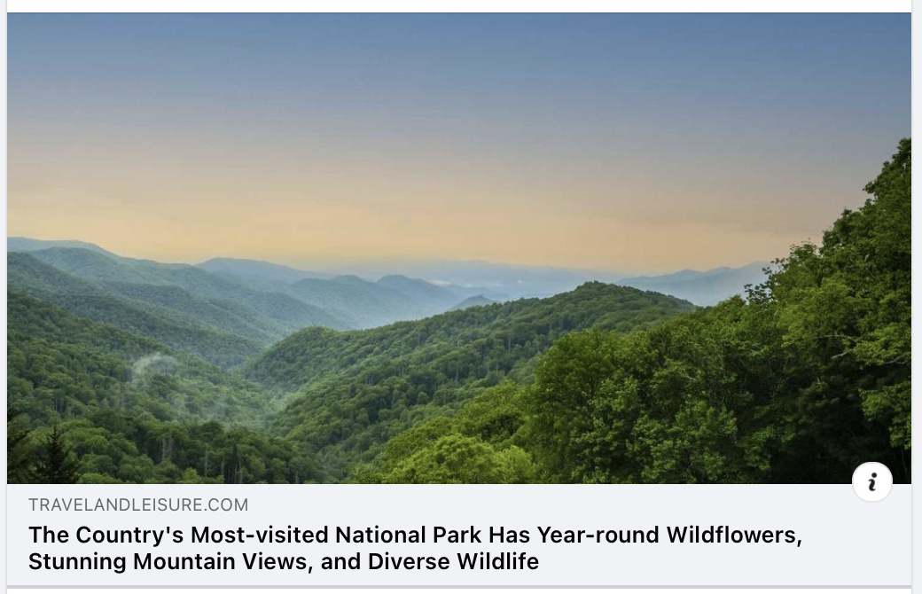

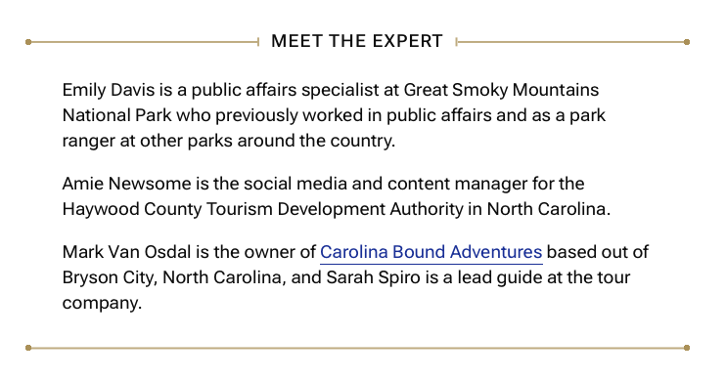
Public Relations Update
https://www.travelandleisure.com/guide-to-great-smoky-mountains-national-park-8557055

Slide 39
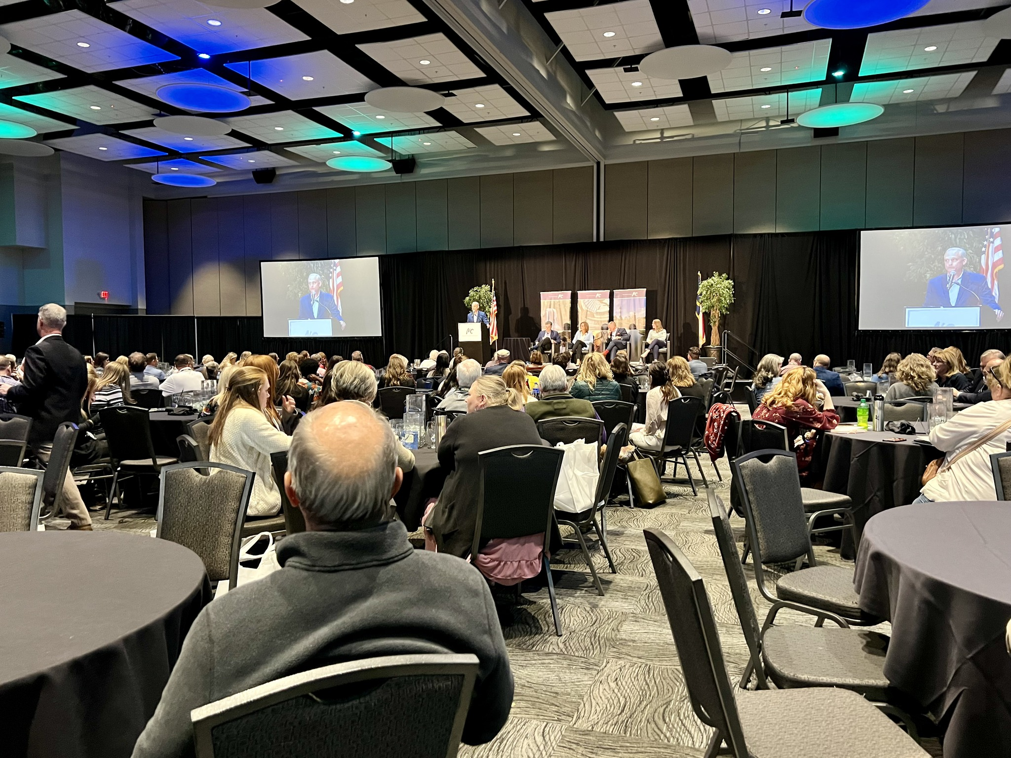

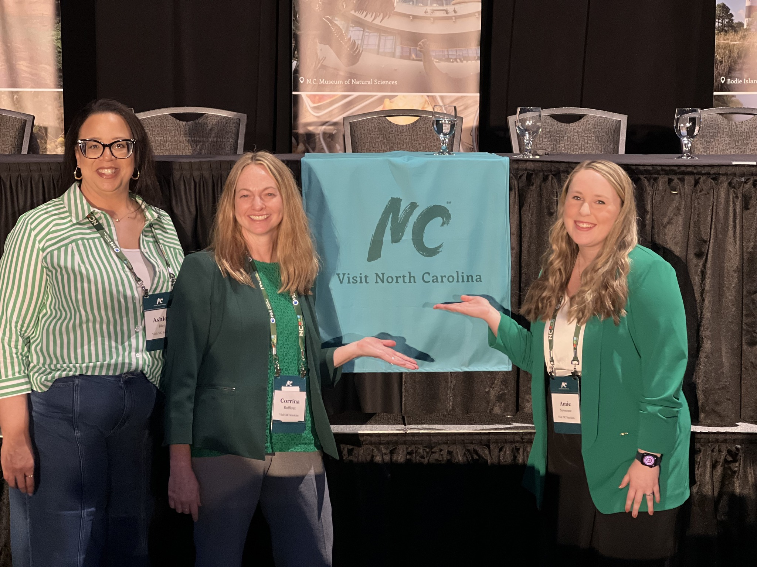
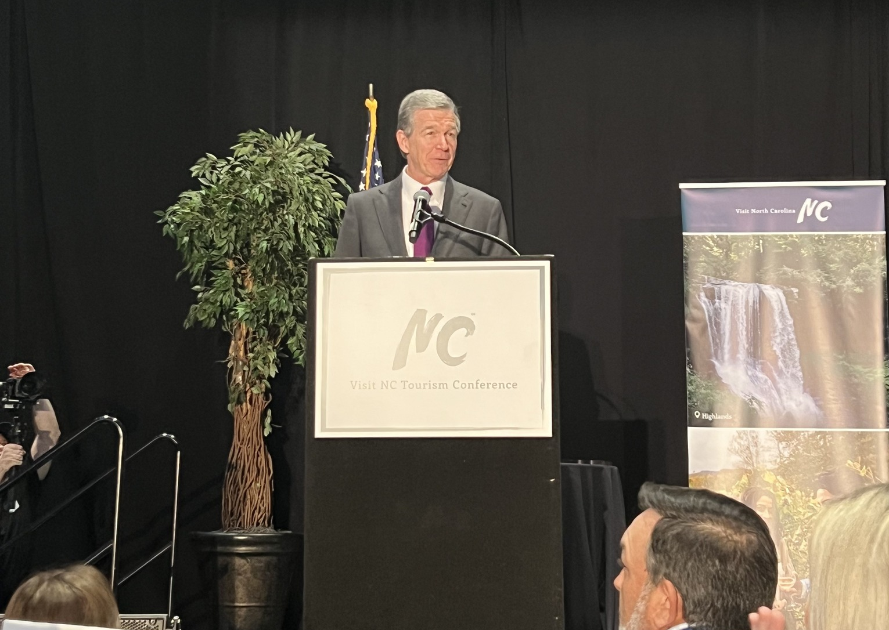
Conference Highlights:
CEO Session
Advanced Social Media Workshop
AI for Destination Marketing
Owned Media Marketing Strategy
Zartico Session
March 17-19, 2024

Slide 40
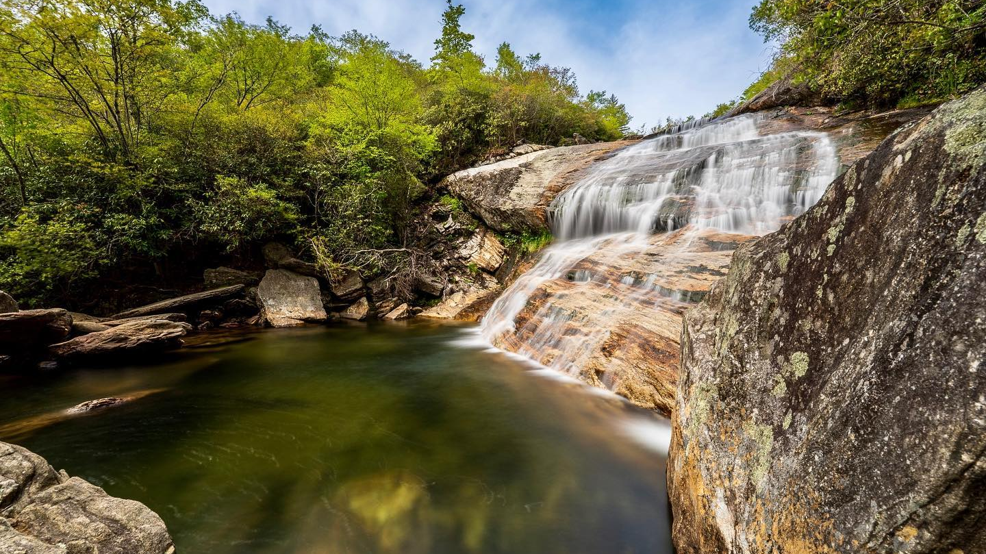
Next TDA Board meeting:
April 24, 2024

Slide 41

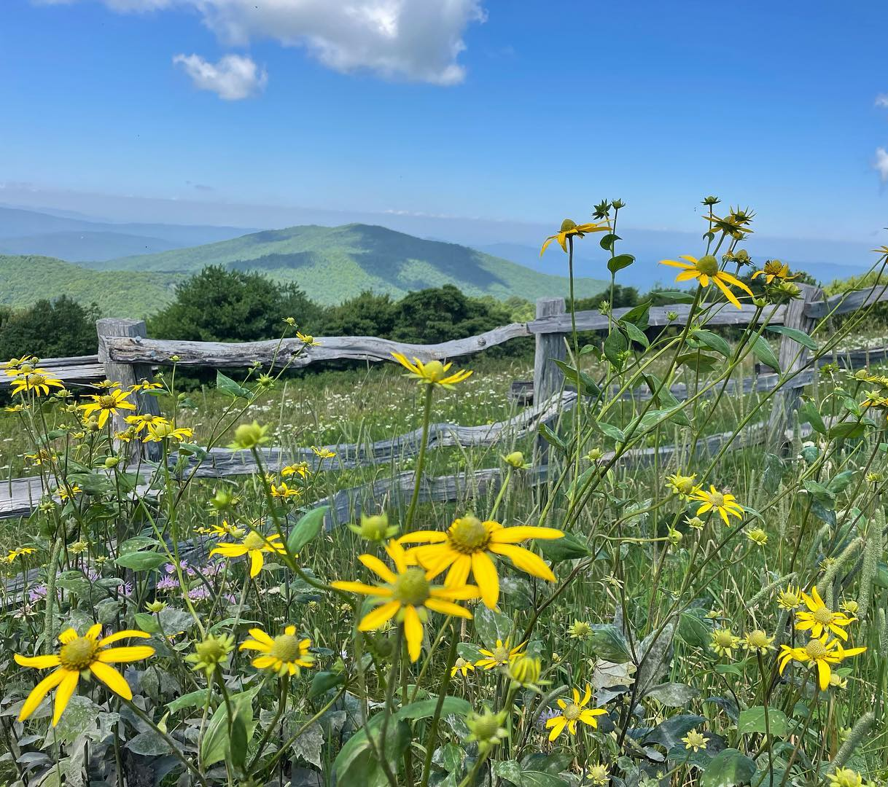

Thank you!

